Slide 1
Glomerulus-Specific, Long-Latency Activity in the Olfactory Bulb Granule Cell Network
Vikrant Kapoor and Nathaniel N. Urban
Department of Biological Sciences and Center for the Neural Basis of Cognition, Carnegie Mellon University
Presented by Rose Psalmond

Slide 2
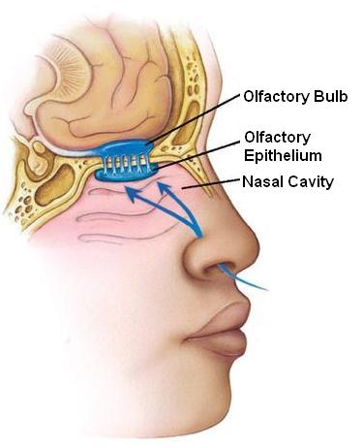
The Olfactory System
Olfaction = sense of smell
A general outline:
Nose =>
Receptors=>
Olfactory bulb =>
other brain areas
Let’s look a little closer
Image from: http://www.mhhe.com/socscience/intro/ibank/ibank/0036.jpg

Slide 3
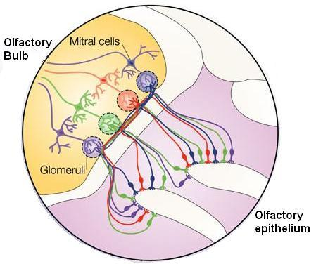
The Olfactory Bulb
  Glomeruli = spherical structures receiving input from same type of receptors
  Glomerular layer combines input from olfactory nerves
  Mitral cell layer =>
  olfactory cortex
  Many interneurons, including granule cells
Image from: http://www.nature.com/nrn/journal/v5/n3/images/nrn1361-i1.jpg

Slide 4
Granule Cells
Axonless (dendrodendritic structure)
Release inhibitory neurotransmitter Gamma-aminobutyric acid (GABA)
Enables lateral inhibition and/or auto-inhibition of mitral cells
Extremely reliable, consistent delay in firing (timescale: 0-1000 ms)

Slide 5
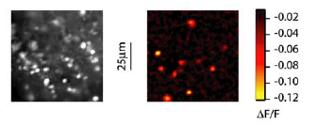
Methods & Calculations
Cells were visualized under infrared differential
interference contrast (DIC) optics recordings.
Cellular activity measured in ΔF/F versus time
Flourescence measures calcium transients, an indicator of cellular activity
The rising phase of the transient corresponds to periods of repetitive firing

Slide 6
Methods & Calculations
Activation latency = time of first deviation from the basal florescence
Rise time = the difference between the time of first deviation and time taken to attain the peak florescence
Probability = # trials with activity (one cell)/ total # of trials
Probability index = mean of probabilities of all cells imaged in a given condition
Pairwise coactivation probability = # trials both cells showed activity/ # of trials.

Slide 7
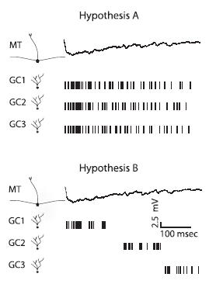
Asynchronous and repetitive firing upon glomerular stimulation
Possible mechanisms for asychrony:
(A) rapid recruitment and persistent activity of granule cells
(B) asynchronous recruitment of a number of granule cells

Slide 8
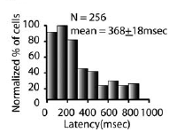
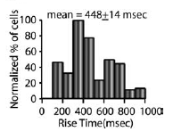
Activation latencies and response time upon glomerular stimulation
Granule cell activation latency histogram showing widely distributed activation latencies.
Granule cell rise time histogram showing widespread distribution of granule cell rise times.

Slide 9
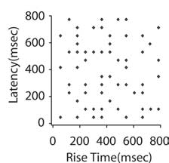
Asynchronous activation of granule cells after stimulation of single mitral cells
Widely distributed activation latencies (not significantly different than after glomerular stimulation)
No correlation between granule cell activation latencies and rise time (r=0.22)

Slide 10
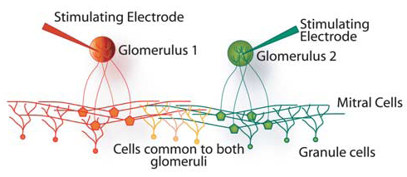
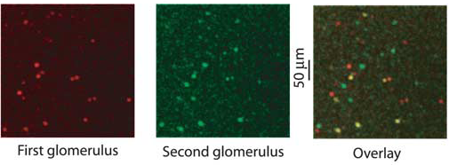
Granule cell latencies are reliable and glomerulus specific
Yellow cells are activated by both the glomeruli.
15–30% overlap

Slide 11
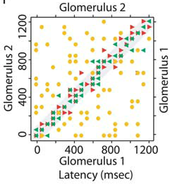
Granule cell latencies are reliable and glomerulus specific
Latencies for the overlapping set of granule cells, for two stimuli of the same (red and green triangles) and for two different glomeruli (yellow circles).
Glomerular identity is coded by the latency of granule cell firing

Slide 12
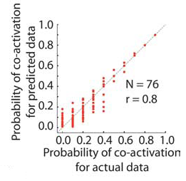
Granule cell activity is uncorrelated
across the population and across trials
Summary plot showing strong correlation between predicted coactivation probability and actual coactivation probability: individual granule cells act independently

Slide 13
Summary & Conclusions
Granule cells fire with long but reliable latencies
This occurs regardless of stimulus input origin (glomerular or from mitral cells)
Latencies varied widely across different cells
Latencies of single granule cells were extremely reliable and input specific
This provides a link between the timing of inhibitory input to mitral cells and odor identification.
The mechanism for granule cell delay is still unclear

Slide 14
My Research
Potassium A-type current accounts for approx. 50% of the latency.
I am investigating this and other potential mechanisms for delay
NMDA, Ca
Susceptibility to noise
Learn more next week!

